Slide 1

Air Education and Training Command
373d Training Squadron Detachment 306
FTSS Software Analysis
TSgt Jeff McCoy

Slide 2
FTSS Software Analysis
PII Concerns
Security & Stability Risks
Implementation & Design Observations

Slide 3
PII Concerns
“PII violations create both a personal and operational risk for all of us.”
- General William L. Shelton, AFSPC/CC

Slide 4
PII Concerns
PII is any information about an individual that can be used directly, or in connection with other data, to identify, contact or locate that person and can include such information as: full name, address, Social Security number, medical, educational, financial, legal and employment records.

Slide 5
PII Concerns
PII breaches are reported to the 24th AF/CC, user account locked out and wing CC notified
Account will only be unlocked once the first O-6 in their chain of command certifies that the individual has accomplished all necessary actions, to include remedial training
http://www.af.mil/News/ArticleDisplay/tabid/223/Article/467371/violators-of-

Slide 6
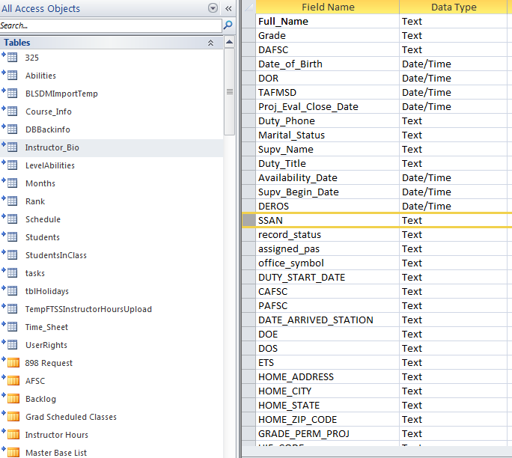
PII Concerns
FTSS v2 & DTMS are both built on MS Access and contain PII (address, SSN, full name, employment records) in plain-text with no access restrictions.
This data, along with nearly 50 other employment data attributes are imported from BLSDM. This data should be removed after the import but a lack of error handling leaves the data vulnerable.
FTSS v2 & DTMS also include a student recall roster function which contain PII

Slide 7
PII Concerns
Resolution: Mitigating the PII risk requires either encrypting the data, restriction permissions to the shared resource or eliminating the PII from the system. Below they are listed in ease of implementation.
Eliminate PII: Remove the BLSDM import feature.
Restrict Permissions: This requires each Det to coordinate with their comm squadron to request rights to manage permissions.
Encrypt Data: Due to limitations in MS Access, the only feasible option is a single-key system where all databases are encrypted with the same password that is controlled by the developers. This would require additional code to protect the key and manage the encrypted connection. I have working code for this that has been tested thousands of times. Note: there is also a compatibility issue between Office 2007 & 2010 with encrypted databases.

Slide 8
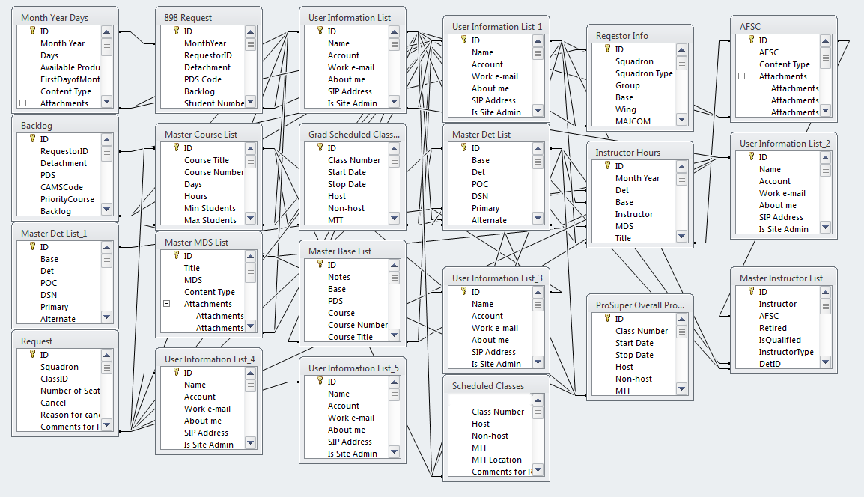
Security & Stability Risks

Slide 9
Security & Stability Risks
Concern: FTSS, FTSS v2 & DTMS all share the same data source including various levels of software testing. This poses a significant risk to the production system if issues arise in the code of one of these products.
Resolution: Mandate duplicate SharePoint sites for different versions, or at a minimum duplicate data when beta testing.
Concern: Several lists are read-write by anyone on the AFNET including the master course lists & 898 requests. If any user were to go to one of these lists and delete one (or all) of the entries, FTSS would fail. Deleting all courses would take only seconds.
Resolution: Establish a security policy for each list in FTSS giving only the minimal permissions necessary to perform authorized tasks.

Slide 10
Security & Stability Risks
Concern: FTSS v2 & DTMS utilize a password authentication mechanism that are stored in plain-text and can be modified by anyone. This means the password mechanism adds no security and exposes a PII vulnerability (exposed passwords).
Resolution: Encrypt the database or eliminate login & authentication.
Concern: FTSS v2 & DTMS are distributed as an ACCDB file which provides full source code and the ability for anyone to modify the front-end producing unexpected or even dangerous results.
Resolution: The insider threat is significantly reduced by publishing a read-only version on a controlled SharePoint site. The better option is to compile and distribute only ACCDR or ACCDE files that contain no source code or ability to manipulate forms regardless of permissions.

Slide 11
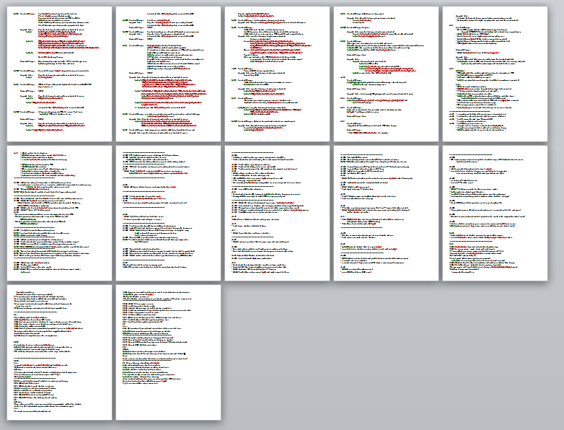
Design Observations
DTMS Change log

Slide 12
Design Observations
Concern: FTSS v2 & DTMS have gone through enormous design changes over time demonstrating a lack of product scope (feature creep) or software architecture.
Resolution: Establish a requirement and keep it through the design phase. Set realistic milestones and track them to completion.
Concern: Both systems utilize linked tables with no accounting for JET (the data engine MS Access uses) record locking and releasing. Eventually, this will create a noticeable latency issue for users.
Resolution: Utilize a well-documented data-binding procedure to keep connections open while the user has the database open. This code is also already a part of the encryption code previously mentioned.

Slide 13
Design Observations
Concern: Very little error handling or code exists to handle edge cases properly. Users are left with confusing error messages often asking to debug the application.
Resolution: Add proper error handling and add a logging or user alert system. Many examples are freely available online.
Concern: Poor or no documentation exists and many functions are unintuitive or confusing. Without good documentation a system will become victim to garbage data or decreased utilization.
Resolution: Provide adequate documentation for all mandated applications. This is a significant task that often requires help beyond the development team to complete.

Slide 14
Design Observations
Concern: Requiring MTFs/UTMs to connect to an Access database to perform tasks that can be done directly on SharePoint is cumbersome, slow and confusing. MS Access should be a very last resort and only used when the functionality needed cannot be done directly in SharePoint.
Resolution: Keep as much of the process natively in SharePoint as possible—add the necessary HTML/JS for anything that is lacking. Alternatively, change to InfoPath for a more integrated, reliable and intuitive scheduling process for customers.

Slide 15
FTSS Software Analysis
PII Concerns
Security & Stability Risks
Implementation & Design Observations

Slide 16

“The World is Our Classroom”

